Slide 1



Discord Guide & Software Tools
A guide for participants and mentors who want to familiarize themselves with Slack & the Software Tools that may be beneficial through the Hackathon. Check out the Hackmakers Slack Video Guide for more depth and simulation of the channels!
If you’re competing - check out the participant guide for the most applicable information. If you’re a mentor - check out this mentor guide. All parties in the hackathon should be familiar with the hackathon overview and rules prior to the event.

Slide 2
Table of Contents
Slide No. | Slide Contents
4 | Introduction to Discord
7 | Working in Discord
8 | Public & Default Channels in Slack
9 | Private Channels in Slack
 | Challenge and Voice Channels in Slack
11 | Software Tools: Ideation & Rapid Build
12 | Software Tools: Demo & Prototyping
13 | Community Technical Tools
15 | More Questions?

Slide 3
Discord Guide
Hackmakers uses Slack to help participants, teams and mentors to interact and collaborate during a hackathon. The video guide will run through:
1. The Discord Welcome Bot
2. Role reactions for challenges and mentors
3. Public channels and how to use them
4. Private channels for mentors and lead mentors
5. Challenge and voice channels

Slide 4
Working in Slack
https://support.discord.com/hc/en-us/articles/360045138571-Beginner-s-Guide-to-Discord Hackmakers is proud to have Discord as a partner throughout all of our hackathons.
We’ll be opening up the Discord server two weeks prior to the hackathon, so get in quick to mingle like your single and introduce yourself, share resources, find teammates, join existing teams and idea generate . We’ll be updating you in #announcement channel on challenge releases and also be running workshops in parallel so you have all the information you need to be ready.
To access the Discord server, please check the confirmation email that you receive after registering on the Hackmakers website.

Slide 5
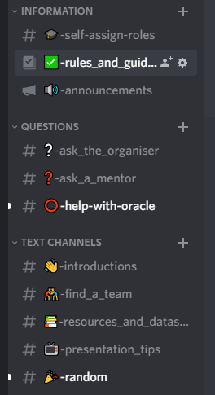
Public & Default Channels on Discord
#rules_and_guidelines: This channel is a static channel containing all the links to rules and guidelines.
#announcements: This is one of the most important channels. Make sure to check this regularly (we recommend at least twice per day) for real time live communication and updates from organisers.
#Introductions: Let us know who you are, your special talents, where are you from and why are you here
#random: A fun channel that people can use for banter, camaraderie and anything else that fancies them.
#resources_and_datasets: Resources or data sets related to hackathon.
#presentation_tips: For mentors who wanted to offer pitch support, online tools to help with their final pitches and Youtube videos
#ask_the_organisers: For any questions you may have to ask the organisers!
Notes:
Where should the actual team finding process go?

Slide 6
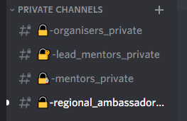
Private Channels on Discord
#mentors_private: For the product folk. If you’re looking for someone who knows a lot about features, problem solving and delivery of product this is the place to find them.
#lead_mentors_private: For the product folk. If you’re looking for someone who knows a lot about features, problem solving and delivery of product this is the place to find them.
#regional_ambassadors_private: A private group for all regional ambassadors selected for this hackathon
#organisers_private: A private group for organisers to liaise with sponsors and community partners during the hackathon.
Notes:
Where should the actual team finding process go?

Slide 7
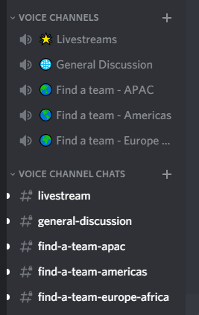
Challenge and Voice channels on Discord
#challenge_1 / #challenge_2 / #challenge_3: For all mentors and participants looking to share resources, ideas, team members and advice on any of the hackathon challenges.
Livestreams: The opening ceremony, awards ceremony and workshops will be livestreamed on our Youtube channel as well as within Discord here.
General Discussion: For anyone who would like to jump in and start talking to the organisers, sponsors or participants!
Find a team - APAC / Find a team - Americas / Find a team - Europe and Africa: Voice channels for anyone looking to join or form a team within specific geographies.
Accompanying text channels: These channels are text channels for anyone in the voice chat that wants to exchange information.
Notes:
Where should the actual team finding process go?

Slide 8
Software Tools & Recommendations

Slide 9
What sources can the teams use for the Ideation phase?
What sources can the teams use for the Rapid Build phase?
Anything that is free and publicly available. For anything that is paid or private, check with the organisers. Based on the challenge we may also provide certain sources as a reference as well.
HackMIT tools: https://code.hackmit.org/
Google Drive: Drive.google.com
Trello: https://trello.com/
Plan.io: https://plan.io/sem/en/scrum-dashboard/
Anything that is free and publicly available. For anything that is paid or private, check with the organisers. Based on the challenge we may also provide certain sources as a reference as well.
Oracle Cloud Infrastructure: https://www.oracle.com/cloud/iaas/training/level-50.html
Pattern Tap: http://zurb.com/patterntap
UX Archive: http://uxarchive.com/
Stock Photos that don’t suck: https://medium.com/@dustin/stock-photos-that-dont-suck-62ae4bcbe01b
Icon Moon: https://thenounproject.com/
Gimp: http://www.gimp.org/
Moqups: https://moqups.com/

Slide 10
What can teams use for the Prototyping & Presentation phase?
When will the submission link open? What are the preferred attachment or video formats?
Anything that is free and publicly available. For anything that is paid or private, check with the organisers. Based on the challenge we may also provide certain sources as a reference as well.
Github student Pack: https://education.github.com/pack
Pitherific: https://pitcherific.com/
Keynote (apple only): http://www.apple.com/ios/keynote/
Slide Rocket: http://www.sliderocket.com/
Prezi: http://prezi.com/
Zoom (screen recording): http://zoom.us/
Document and youtube links will be the preferred submission formats.
Typeform to submit will be released in the announcements channel on the first day of the hackathon!

Slide 11
Community Technical Tools (Part 1)
Our community have also recommended tools that they have used to win hackathons in the past! Check them out here:
https://miro.com: team collaboration, charts and planning
https://airtable.com: collect data via a form view and manipulate it via table view
https://bubble.io: build full apps without coding (database, view, logic)
https://www.glideapps.com: build mobile web apps in minutes
https://firebase.google.com: powerful and easy to setup backend with api and websocket support
https://backendless.com: powerful and easy to setup backend with api and websocket support
https://www.invisionapp.com/studio: easy to use design tool with click-dummy features
https://workstreams.ai: results-oriented, data-driven task management solution & kanban board app integrated to Slack
https://appsheet.com: create apps based on a google sheet as its database (has covid offering)

Slide 12
Community Technical Tools (Part 2)
https://webflow.com: very easy and powerful tool to create websites (with cms database)
https://www.splunk.com: collect, analyze and act on data points
https://rapyd.ai: ai-as-a-service platform for rapid AI prototyping
https://www.typeform.com: super easy forms to collect and evaluate data - chat to #typeform if you need help
https://stackedit.io/app: markdown editor (browser based)
https://settlemint.com: from blockchain concept to deployed solution in 1 hour
https://developer.here.com: location apis and sdks
https://www.stryke.io: build cloud apps easily and quickly (free)
https://console.prisme.ai/en: create conversational interfaces (chatbots, mobile application in the form of bots) with free support
https://walls.io: aggregate social media content to display it or consumre it via api (display, api)

Slide 13

More questions?
I want to know more about this hackathon:
Hackathon FAQ Quickstart Guide: https://docs.google.com/presentation/d/1by21Mh4YueRPyNdTgt17tqM5DXdD4LiICG4SGMJUcy4/edit?usp=sharing
I want to be a mentor/ understand who mentors are:
Make a new registration as a mentor at: www.hackmakers.com
Read through the Mentor Guide: https://docs.google.com/presentation/d/1jL7CHdheH98y7gaUmsBF8nu8PgTfg7-e9vXNEzbIPbE/edit?usp=sharing
I want to know the general rules and regulations:
https://docs.google.com/presentation/d/1l0cdM_6tacrpiHgCyU6g039THDrSuuEB2fypcgnUShI/edit?usp=sharing

